Slide 1
Intelligent DFT and Signal Extrapolation
By: Oisín Watkins

Slide 2
Contents
The Background
This Mini-Project.
What’s Out There
The Mathematics
The Demo
What’s Next

Slide 3
The Background
Late last year I began reading into AI systems which process frequency-domain data to understand the world. For example, Mathworks trained a Convolutional Neural Network (CNN) to differentiate the RADAR signal returned from a pedestrian vs. the signal returned from a cyclist, a car, a truck, etc.
Other examples are out there, but they all have 1 common pre-process that they must run before feeding data into their Neural Network: Perform an FFT and process the returned data into an image for the CNN.

Slide 4
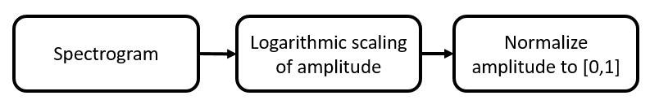
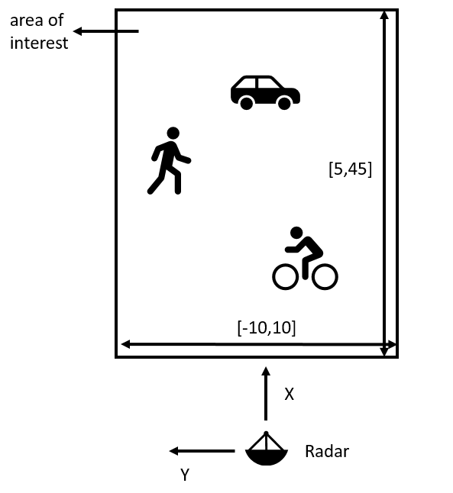
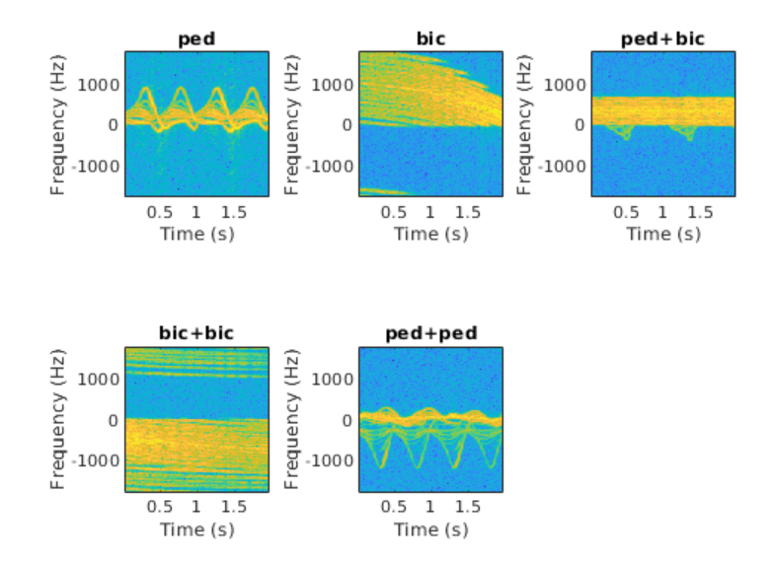
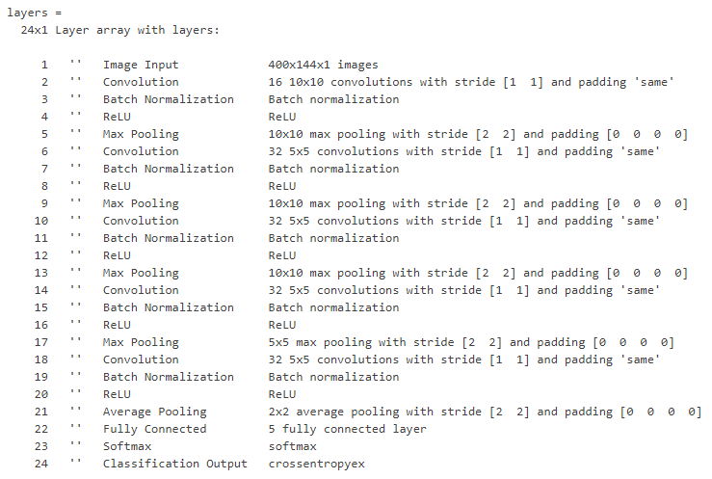
The Background
Source: https://uk.mathworks.com/help/deeplearning/ug/pedestrian-and-bicyclist-classification-using-deep-learning.html

Slide 5
The Background
This approach has a couple of issues, but the biggest among them is the lack of versatility. For this system to be deployed to an edge sensor system you need to fit that edge sensor with a Spectrogram and the equipment / processing power needed to process colour images in real-time.
So my original goal is simple: Develop the framework needed to feed actual signal data into a Neural Network in real-time for edge sensor systems.

Slide 6
This Mini-Project
Fast Forward to May 2020, I’m no longer in the RADAR group. While I still want to develop this system, I need to demonstrate its applicability outside of the RADAR field.
So before developing the framework, I decide to demonstrate the concept itself in simple mathematics.
To do this, I decide to tackle the issue of Bit Error Rate Reduction in high-noise RF systems.

Slide 7
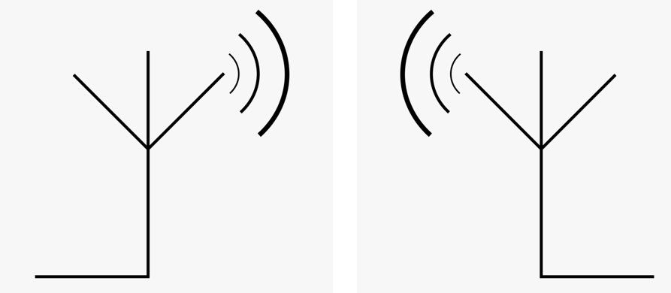
This Mini-Project
Random Blocker Signal
Filter, FFT and Post-Process
Noisy Transmission Medium
Compare Bit Error Rates
Filter, Intelligent-DFT and Extrapolate Signal

Slide 8
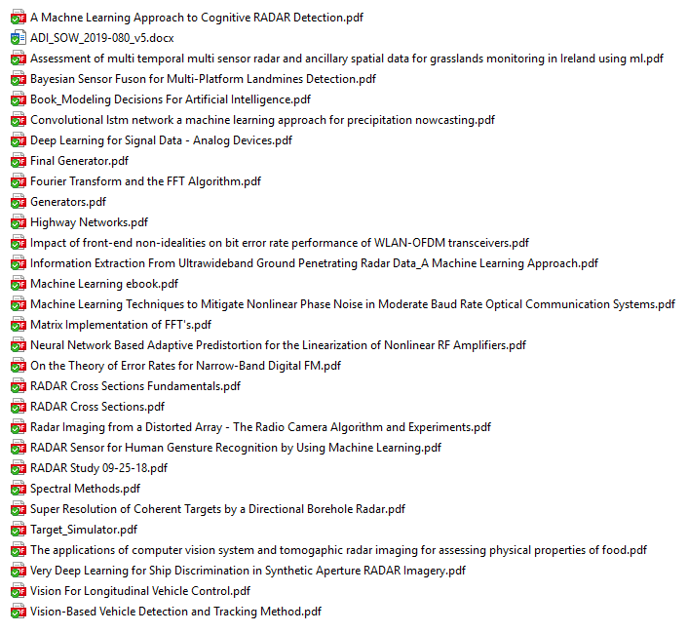
What’s Out There
These are all the research papers I’ve ensembled for the greater project.
For the mini-project, I’m going to focus on only 4.

Slide 9
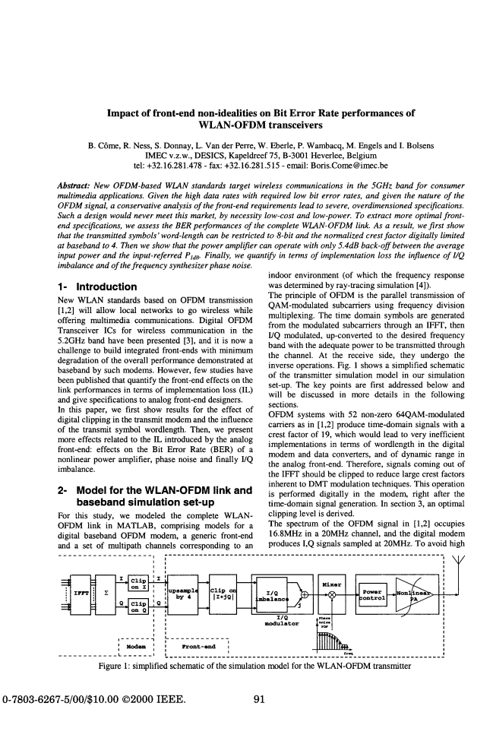
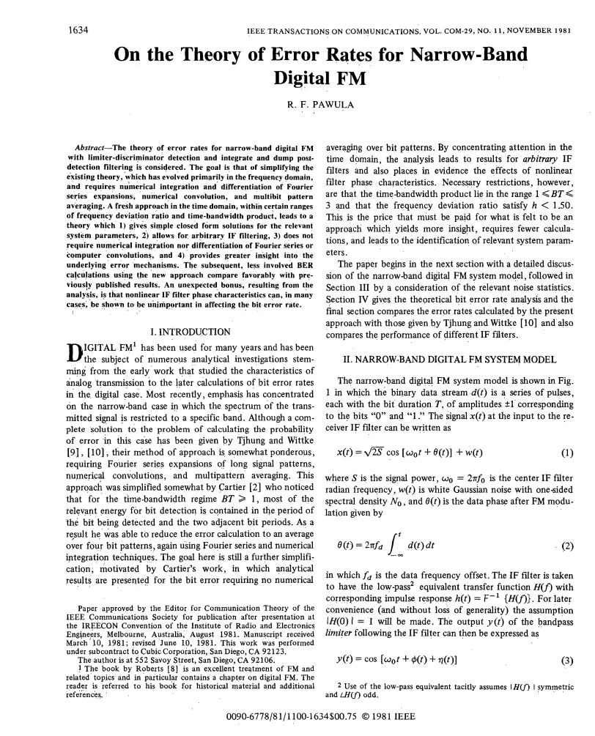
What’s Out There
This paper, written by R. F. Pawula et al in 1981, sought to simplify the algorithm calculating the probability
of error given by Tjhung and Wittke in 1970.
While not the most relevant paper, it does provide useful context given its focus on Narrowband FM design, sources of error in FM trasmissions.
Written by B. Came et al in 2000, this paper attempts to detail the contribution to Bit Error Rate in 5GHz systems of non-idealities in the RF Front end with the hope of simplifying the RF system standards.
Again, this paper does not focus on the same topic field as my project, however it does go into detail on how each system error in RF transmission affects the overall system performance.

Slide 10
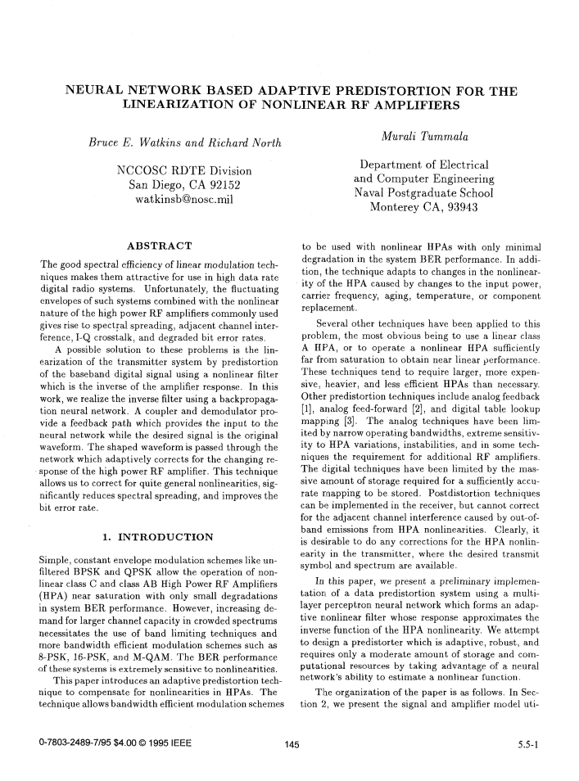
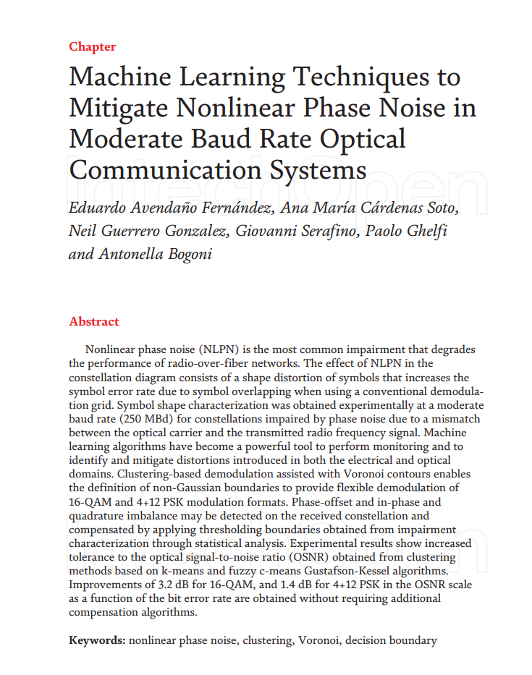
What’s Out There
This paper, written by Bruce E. Watkins et al in 1995, attempted to apply Neural Networks to solve the issue of PA non-linearities.
Essentially they developed an AI version of DPD. Although they were ultimately successful at linearizing the PA output this solution never took off.
Reasons for this could be manifold. They could include complexity, lack of transparency, difficulty in deployment, etc.
This paper, written by Eduardo Avendano Fernández et al in 2019, considered the application of various machine learning tactics to increase the tolerance to signal error in Optical Systems.
They proposed a modified version of Fuzzy c-means Gustafson-Kessel as an alternative decision boundary deriver to performing the demodulation-based clustering commonly employed. They noted reduced Bit Error Rates as a result.
Our projects differ in philosophy.

Slide 11
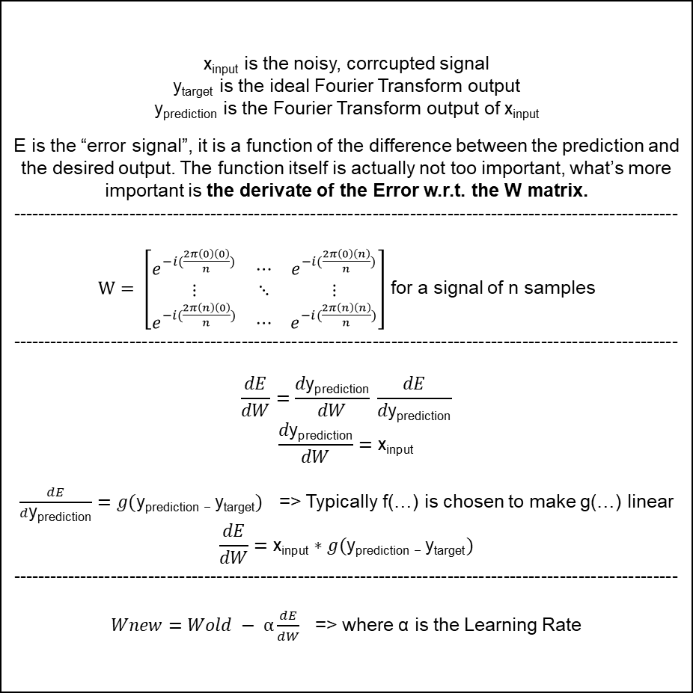
The Mathematics
y_{output}
x_{input} is the noisy, corrcupted signal
y_{target} is the ideal Fourier Transform output
y_{prediction} is the Fourier Transform output of x_{input}
E is the “error signal”, it is a function of the difference between the prediction and the desired output. The function itself is actually not too important, what’s more important is the derivate of the Error w.r.t. the W matrix.
-----------------------------------------------------------------------------------------------------------
$W= \left[\begin{matrix}e^{−i(\frac{2π\left(0\right)\left(0\right)}{n})} & ⋯ & e^{−i(\frac{2π\left(0\right)\left(n\right)}{n})} \\ ⋮ & ⋱ & ⋮ \\ e^{−i(\frac{2π\left(n\right)\left(0\right)}{n})} & ⋯ & e^{−i(\frac{2π\left(n\right)\left(n\right)}{n})}\end{matrix}\right]$ for a signal of n samples
-----------------------------------------------------------------------------------------------------------
$$\frac{dE}{dW}=\frac{d\text{y}\text{prediction}}{dW} \frac{dE}{d\text{y}\text{prediction}}$$
$$\frac{d\text{y}\text{prediction}}{dW}=\text{x}\text{input}$$
$\frac{dE}{d\text{y}\text{prediction}}=g(\text{y}\text{prediction}\text{ − }\text{y}\text{targe}\text{t})$ => Typically f(…) is chosen to make g(…) linear
$$\frac{dE}{dW}=\text{x}\text{input}∗g(\text{y}\text{prediction}\text{ − }\text{y}\text{target})$$
-----------------------------------------------------------------------------------------------------------
$Wnew=Wold − α\frac{dE}{dW}$ => where α is the Learning Rate
Abs
y_{prediction}
E = f(y_{prediction} - y_{target})
W
x_{input}
y_{target}

Slide 12
The Mathematics
y_{output}
x_{input} is the noisy, corrcupted signal
y_{target} is the ideal Fourier Transform output
y_{prediction} is the Fourier Transform output of x_{input}
E is the “error signal”, it is a function of the difference between the prediction and the desired output. The function itself is actually not too important, what’s more important is the derivate of the Error w.r.t. the W matrix.
-----------------------------------------------------------------------------------------------------------
$W= \left[\begin{matrix}e^{−i(\frac{2π\left(0\right)\left(0\right)}{n})} & ⋯ & e^{−i(\frac{2π\left(0\right)\left(n\right)}{n})} \\ ⋮ & ⋱ & ⋮ \\ e^{−i(\frac{2π\left(n\right)\left(0\right)}{n})} & ⋯ & e^{−i(\frac{2π\left(n\right)\left(n\right)}{n})}\end{matrix}\right]$ for a signal of n samples
-----------------------------------------------------------------------------------------------------------
$$\frac{dE}{dW}=\frac{d\text{y}\text{prediction}}{dW} \frac{dE}{d\text{y}\text{prediction}}$$
$$\frac{d\text{y}\text{prediction}}{dW}=\text{x}\text{input}$$
$\frac{dE}{d\text{y}\text{prediction}}=g(\text{y}\text{prediction}\text{ − }\text{y}\text{targe}\text{t})$ => Typically f(…) is chosen to make g(…) linear
$$\frac{dE}{dW}=\text{x}\text{input}∗g(\text{y}\text{prediction}\text{ − }\text{y}\text{target})$$
-----------------------------------------------------------------------------------------------------------
$Wnew=Wold − α\frac{dE}{dW}$ => where α is the Learning Rate
Abs
y_{prediction}
E = f(y_{prediction} - y_{target})
W
x_{input}
y_{target}
Signal Extrapolation

Slide 13
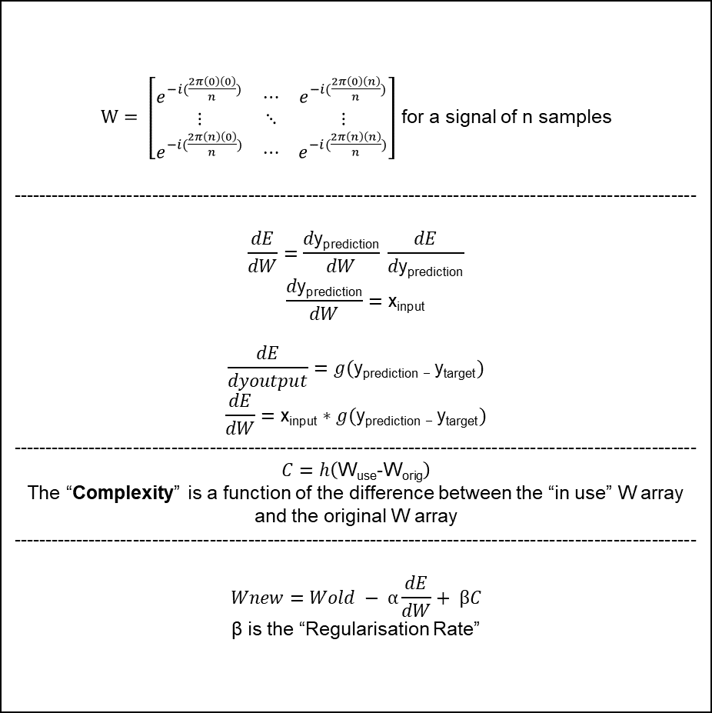
The Mathematics
y_{output}
$W= \left[\begin{matrix}e^{−i(\frac{2π\left(0\right)\left(0\right)}{n})} & ⋯ & e^{−i(\frac{2π\left(0\right)\left(n\right)}{n})} \\ ⋮ & ⋱ & ⋮ \\ e^{−i(\frac{2π\left(n\right)\left(0\right)}{n})} & ⋯ & e^{−i(\frac{2π\left(n\right)\left(n\right)}{n})}\end{matrix}\right]$ for a signal of n samples
-----------------------------------------------------------------------------------------------------------
$$\frac{dE}{dW}=\frac{d\text{y}\text{prediction}}{dW} \frac{dE}{d\text{y}\text{prediction}}$$
$$\frac{d\text{y}\text{prediction}}{dW}=\text{x}\text{input}$$
$$\frac{dE}{dyoutput}=g(\text{y}\text{prediction}\text{ − }\text{y}\text{targe}\text{t})$$
$$\frac{dE}{dW}=\text{x}\text{input}∗g(\text{y}\text{prediction}\text{ − }\text{y}\text{target})$$
-----------------------------------------------------------------------------------------------------------
$C=h\left(\text{W}\text{use}\text{-}\text{Wor}\text{ig}\right)$
The “Complexity” is a function of the difference between the “in use” W array and the original W array
-----------------------------------------------------------------------------------------------------------
$$Wnew=Wold − α\frac{dE}{dW}+ βC$$
β is the “Regularisation Rate”
Abs
y_{prediction}
E = f(y_{prediction} - y_{target})
W_{use}
C = h(W_{use} - W_{orig})
W_{orig}
x_{input}
y_{target}

Slide 14
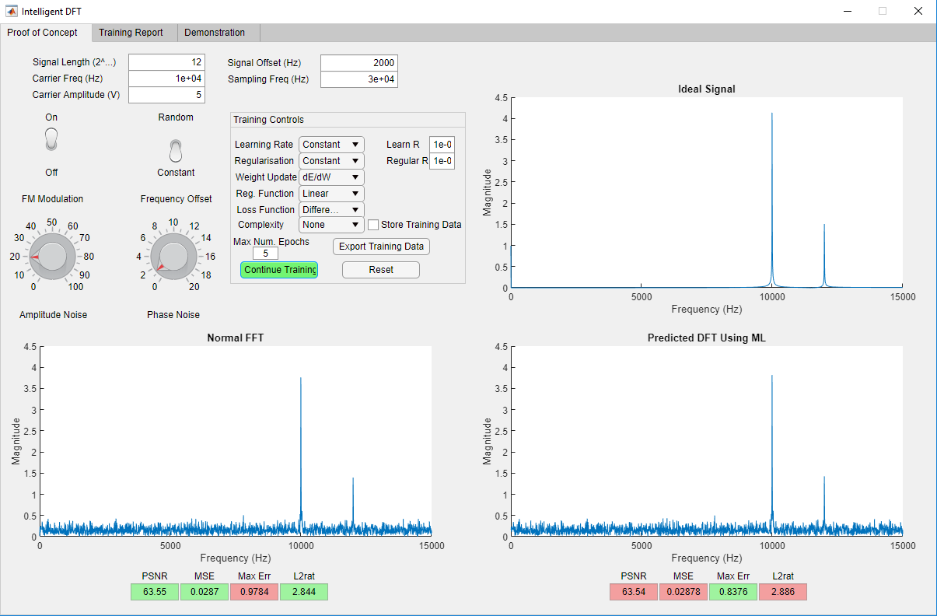
The Demo

Slide 15
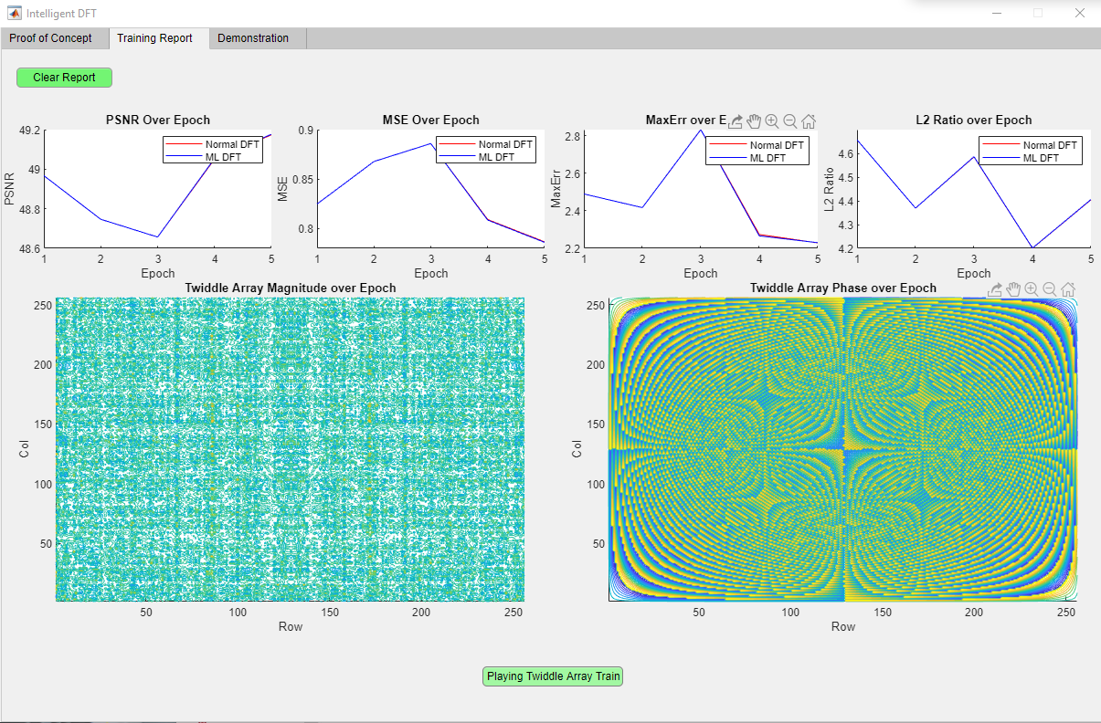
The Demo

Slide 16
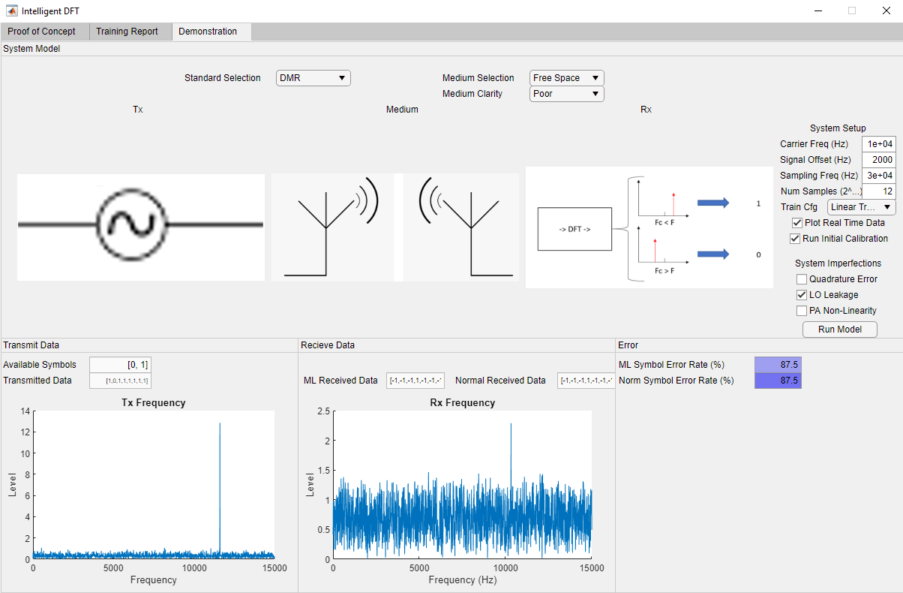
The Demo

Slide 17






What’s Next

